Slide 1
Face Emotion Detection
Sure ProEd – Yaswanth Guptha

Slide 2
1.1 Face Emotion Detection
Face Emotion Detection is a Deep Learning-based technology used to identify human emotions from facial expressions using images or videos.
Project Extention:
As SURE ProEd is conducting daily online classes, Face Emotion Detection can be developed as a Browser Extension to help mentors easily track students' emotions. This will make student monitoring easy through emotion classification.

Slide 3
1.2 about Dataset
Dataset Name: MMAFEDB
Label | Emotion
0 | Angry
1 | Disgust
2 | Fear
3 | Happy
4 | Sad
5 | Surprise
6 | Neutral

Slide 4
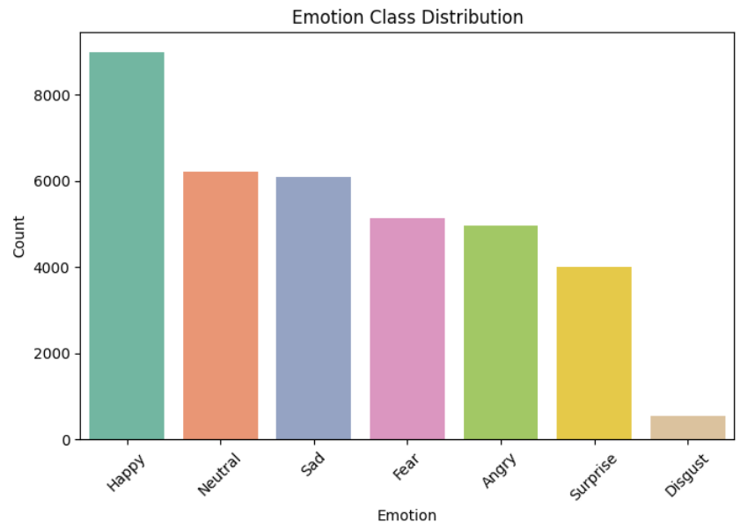
1.3 about Dataset
The distribution suggests a focus or inclination toward positive emotions, particularly happiness, compared to others.

Slide 5
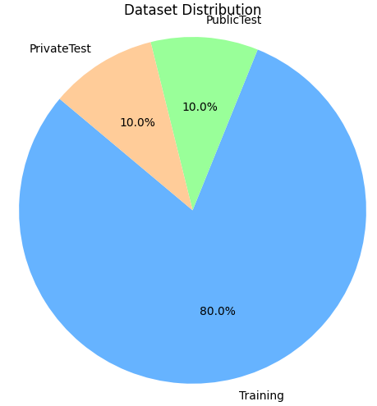
1.4 about Dataset
Training: 32701
Private Test: 3589
Public Test: 3589

Slide 6
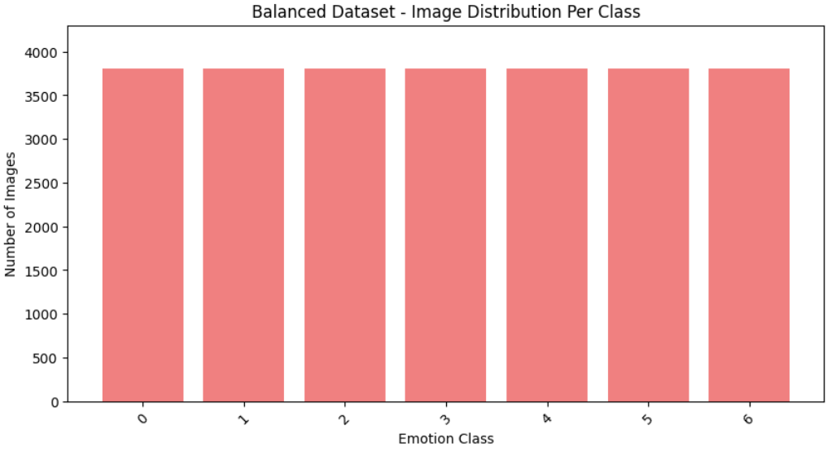
1.5 about Dataset
After Data Argumentation each class have 3803*7 = 26621

Slide 7
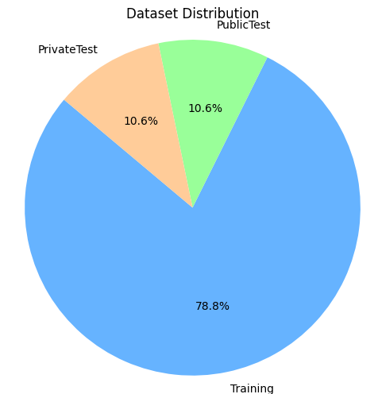
1.6 about Dataset
Training: 26621
Private Test: 3589
Public Test: 3589

Slide 8
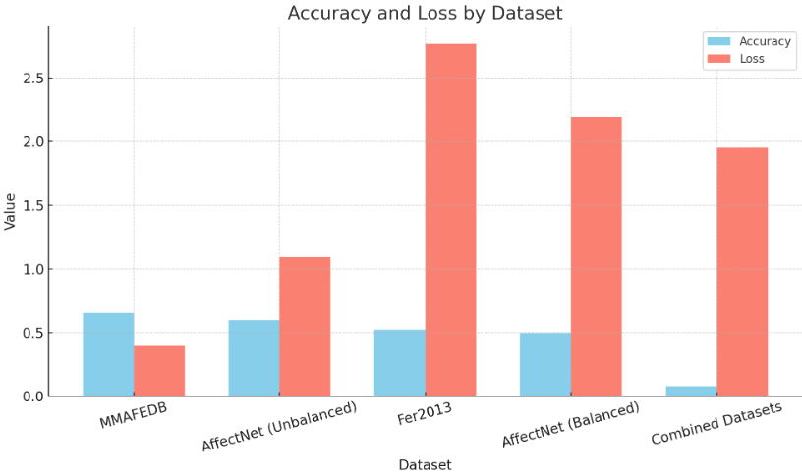
1.7 Face Emotion Detection
Dataset | Accuracy | Loss
MMAFEDB | 0.6543 | 0.3945
AffectNet (Unbalanced) | 0.5969 | 1.0915
Fer2013 | 0.5215 | 2.7690
AffectNet (Balanced) | 0.4977 | 2.1932
Combined Datasets | 0.0779 | 1.9514

Slide 9
1.8 CNN Model
Model Used: Convolutional Neural Network (CNN)
Layer Type | Details
Input Layer | Input Shape = (48, 48, 1)
Conv2D + BatchNormalization | 3 Convolution Blocks with 64, 128, 256 filters
MaxPooling2D | After each Conv Block
Dropout | Dropout Rate = 0.3
Flatten | Converts 2D Feature Maps to 1D
Dense Layer | Fully Connected Layer
Output Layer | Softmax Activation — 7 Classes

Slide 10
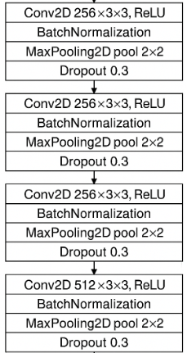

1.9 Model Architecture
Model Used: Convolutional Neural Network (CNN)
Flatten
Output
Input

Slide 11
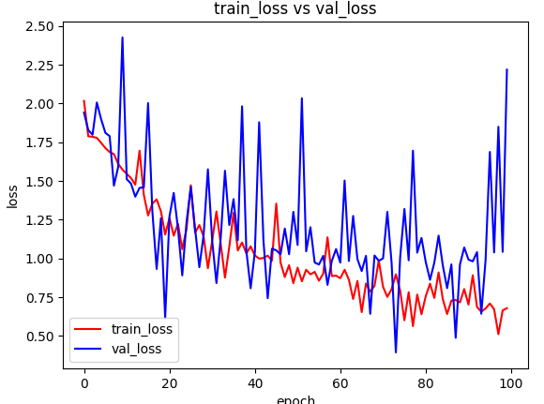
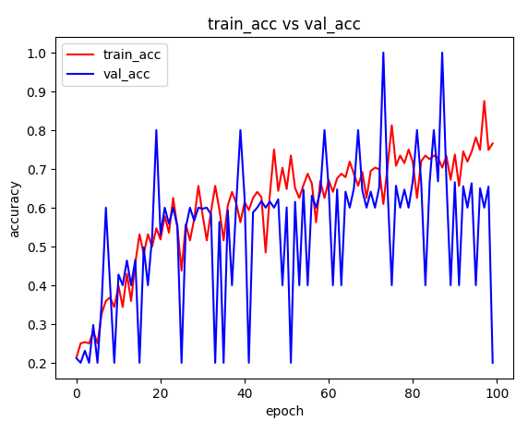
1.10 Evaluation on Test Data
Test Loss | 1.03
Test Accuracy | 65.53%

Slide 12
1.11 Application
Tools & Technologies Used:
Frontend:
HTML, CSS, JavaScript
Backend:
Python (Flask Framework)
Face Recognition:
haarcascade_frontalface_default

Slide 13
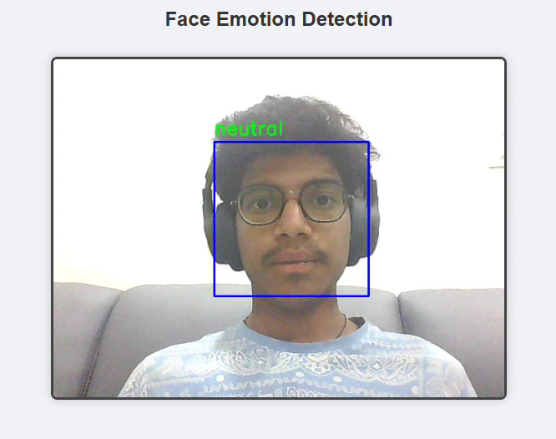
1.12 OutPuts

Slide 14
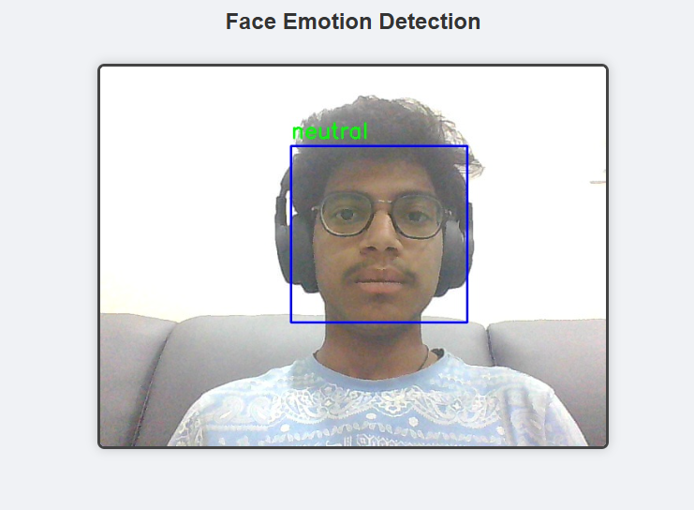
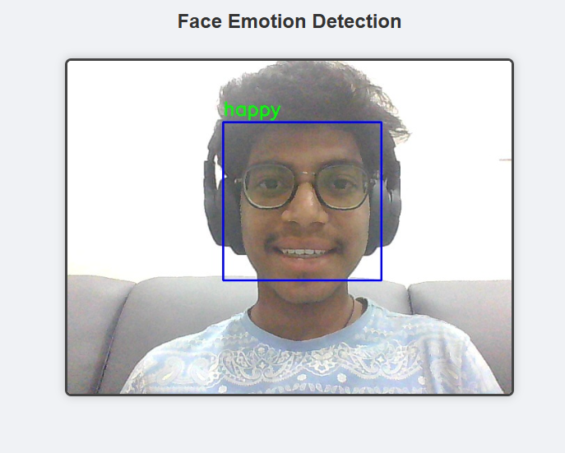
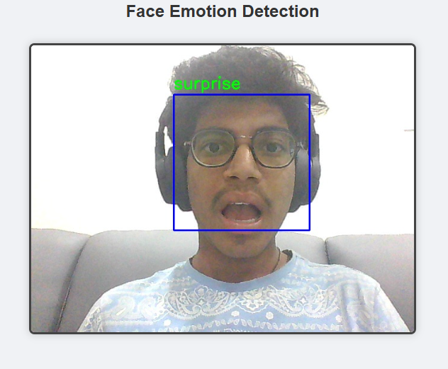
OutPuts

Slide 15
Thank You

